Slide 1
Housing and Work Incentives
Dave Power
Group Chief Executive - One Manchester
Greater Manchester Chief Executive Lead –
Employment & Skills
Email: dave.power@onemanchester.co.uk

Slide 2
Devolution will contribute to our capacity to achieve the growth and reform ambition set out in the GM Strategy
Our ambition is to achieve sustainable economic growth, where all residents contribute and benefit from sustained prosperity
Connecting our people and neighbourhoods to growth
Transforming services to meet the needs of local residents and to meet the financial challenge of 2015/16 and beyond
Becoming financially self sufficient, recognising the role public service reform, as well as growth, will play in achieving this goal
The outcomes of the Review process are significant in terms of supporting GM’s ambitions around growth and reform and key to delivering aspects of the devolution agreement

Slide 3
Outcomes: Breaking the cycle of worklessness, low skills and productivity

Slide 5
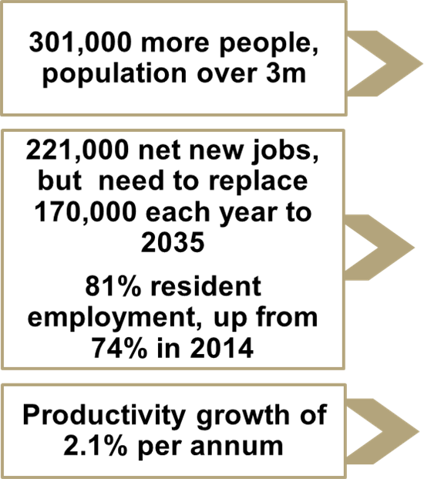
GM’s economic strength & assets will enable us to play a leading role in the northern powerhouse

Slide 6
Track record
One Manchester recognised regionally and nationally recognised for innovative employment and skills work
Supported 1500+ customers into jobs
900+ have completed training
Place 241 customers into work placements
Enterprise, creation and support
Social economy
Innovative spaces in the community

Slide 7
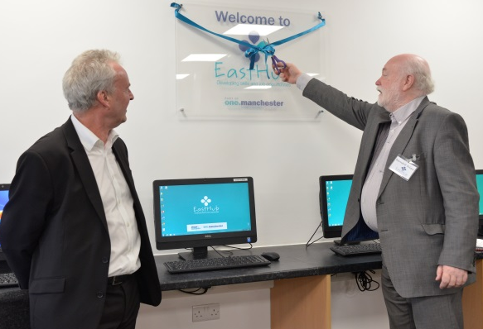
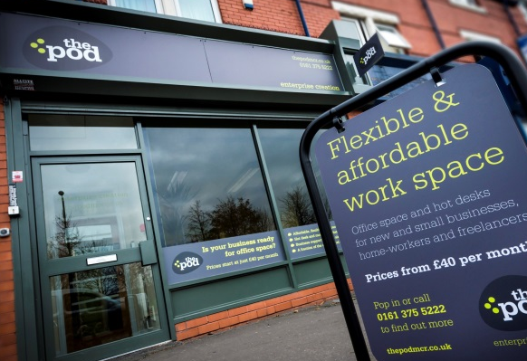
Track record
East Hub
The Pod
The Works
The Place
Notes:
Employer & customer led
Example – The Works – University & Central Manchester Hospital Trust
We have established centres for delivering employment and skills including The Works and more recently East Hub which has had over 700 customers since April
Worked with a wide range of local employers – what skills & expertise they need and preparing customers for these jobs
Focused our training and skills in those sectors with jobs, so customers more likely to obtain work once completed training

Slide 8
Enterprise
Ivy Bell
Moss Cider

Slide 9
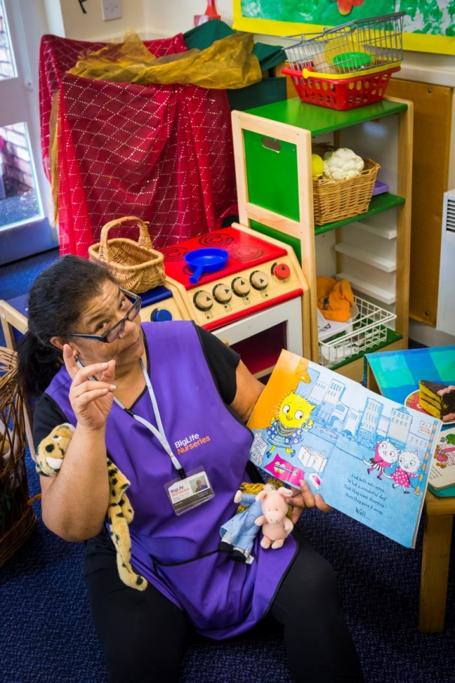
Employer and customer-led
Notes:
Examples include; Retail, Customer Service, Hotel & catering, Health & Social Care, Warehouse & distribution, janitorial
Utilised local businesses and supply chain partners for placements , and developed links with employers in key entry level sectors such as Health & Social Care, Retail & Customer service – evolved into Job brokerage
Piccadilly hoteliers forum
Hilton Hotel
Future directions – health & social care provider
Big life – social enterprise
Training & education - Mantra learning
Mcr Adult Education service
Mcr college

Slide 10
Track record - Volunteering
Notes:
147 volunteers have supported the services we provide
In 2015 volunteers contributed over 2200 hours .
This enabled us to retain and improve services such as homework club, digital inclusion support, job club, and library service.

Slide 11
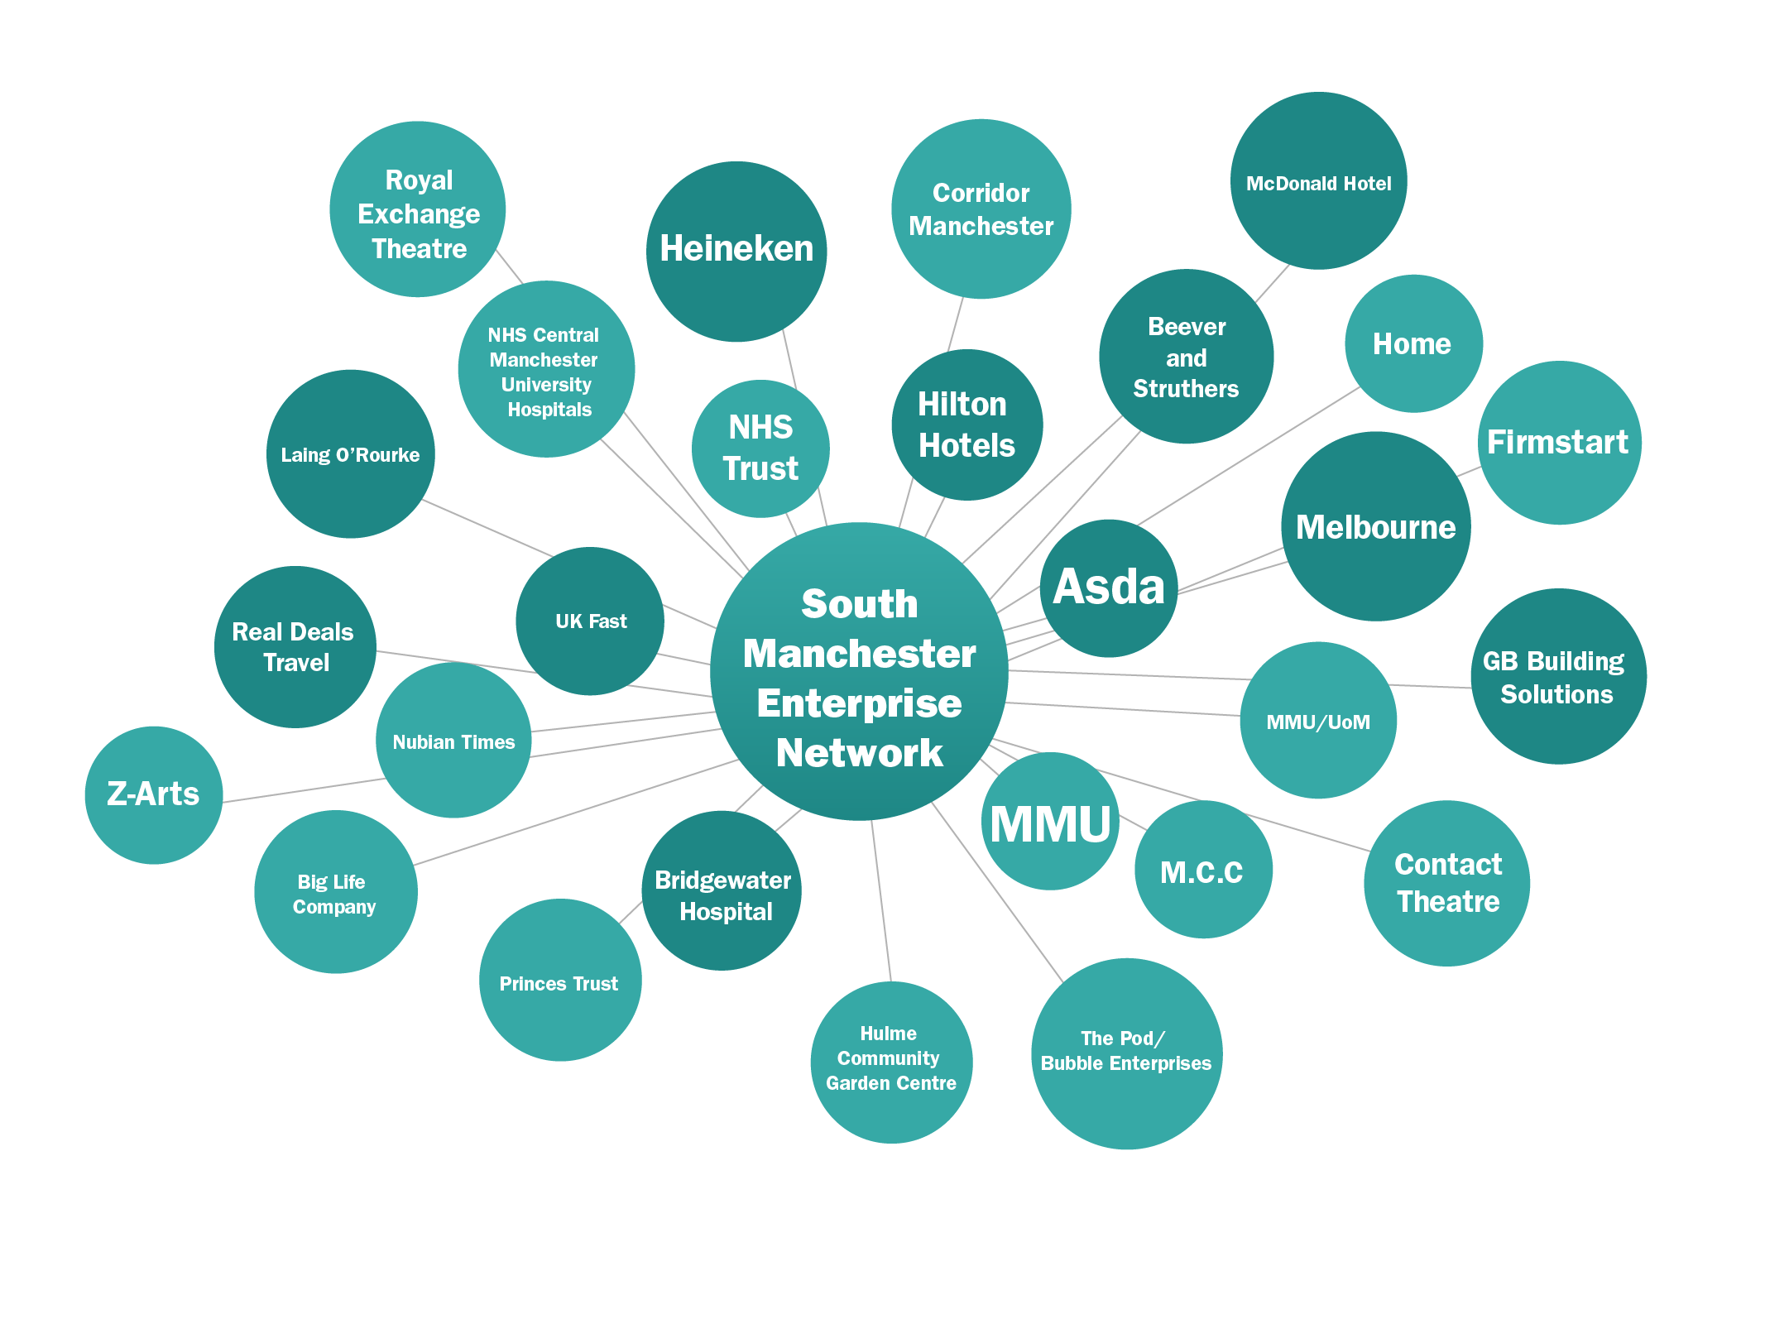

Slide 12
South Manchester enterprise network (SMEN)
Notes:
SMEN has already proven to be a unique combination of CSR activity aimed at the local community, together with a programme of useful business support, good practice ideas and a great regular lunchtime networking opportunity at venues which rotates among the growing membership of businesses.
key examples of business support and good practice which the Network has provided has been around;
Finance for Business
Funding for Wi Fi
Funded Skills Training for employees
Social media
Apprenticeships
Business mentoring
Procurement readiness workshops

Slide 13
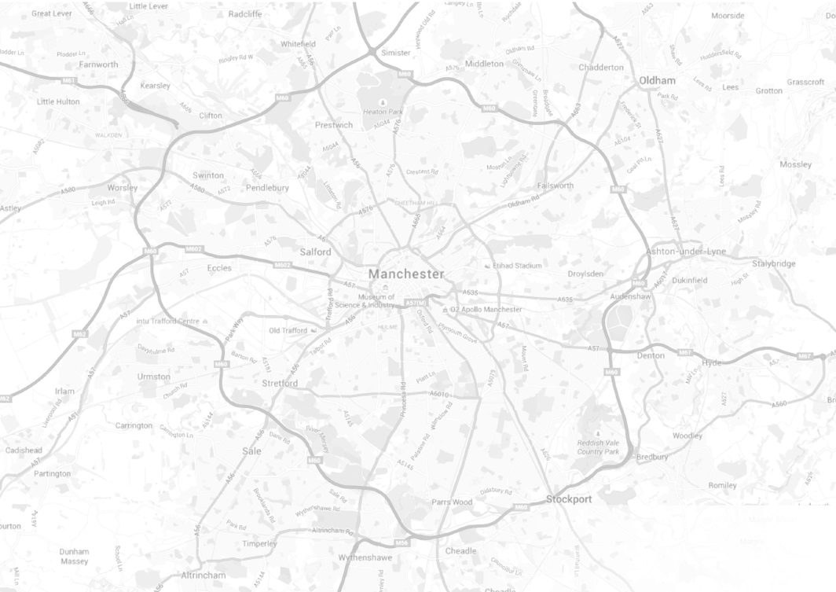
Scale & Impact
One Manchester Locality
Manchester
Greater
Manchester

Slide 14
Delivering GM Growth and Reform
1 in 4 homes in GM – connectivity and insight at locality
Organisation and Focus
GM Providers Group – 25
Portfolio Leads
• Housing Growth • Health & Social care
• Criminal Justice and Police • Place Leadership
• Low Carbon • Public Service Reform
• Employment and Skills
Ask and offer
RPs on GMCA
Memorandum of Understanding – April 2016

Slide 15
Deep dives highlight skills as critical issue for growth
Improving position, but GM’s skills challenges remain
11% of residents hold no qualifications compared to 9% in UK (down from 20% in ‘04)
32% of GM have L4+ qualifications compared to 36% in UK (up from 25% in ‘04)
46% of GM do not achieve 5+ GCSEs inc. English and Math at 15 (falls to 34% by 19)
16-18 app numbers have been flat for past four years at 8,000. However, rise in 19+ has driven growth in overall apps (from 12,500 in 08/09 to 29,700 in 14-15)
Clear link between qualification achievement and ability to contribute to and benefit from growth
Employment rate rises from 37% for those with no qualifications, to 66% for those with Level 2 and 83% with Level 4 and above
230,000 GM residents are out of work and want a job, around a third (85,000) do not have a Level 2 equivalent qualification
Median hourly wages increase with skill level. Those with no/Level 1 earn around £8-£10.35 an hour, which rises to £12.62-£19.82 for those qualified to Level 4+
Ability/incentive to access jobs across GM rises with skill. 36% of those with Level 4+ travel 10km+ to work compared to just 18% of those with no qualifications

Slide 16
Deep dives highlight skills as critical issue for growth
Skills issues routinely flagged up by employers as key issue
Employers across all sectors cite skills as a key driver of, and barrier to growth
Shortage of digital/tech skills raised as a key emerging gap, across all sectors
But need to consider issue of low demand/utilisation of skills by employers too

Slide 17
As a sector, in 2014 we:
Invested over £2.5 million to directly deliver or commission pre – employability, employability, self –employment & enterprise activities
Supported 3,000 individuals
Tendered for and managed over £1 million of external funding

Slide 18
ESIF 2015 -2020
GM Registered Providers have established a consortium to scope the opportunities presented by the ESIF Skills & Employment funding opportunity 2015- 2020
Our consortium currently consists of 13 Registered Providers across the sub –region representing Greater Manchester’s footprint
We have also partnered with a range of organisations from the public, private and voluntary sectors

Slide 19
Notes:
Symphony housing
Wigan & leigh housing
Are both about to join Athena

Slide 20
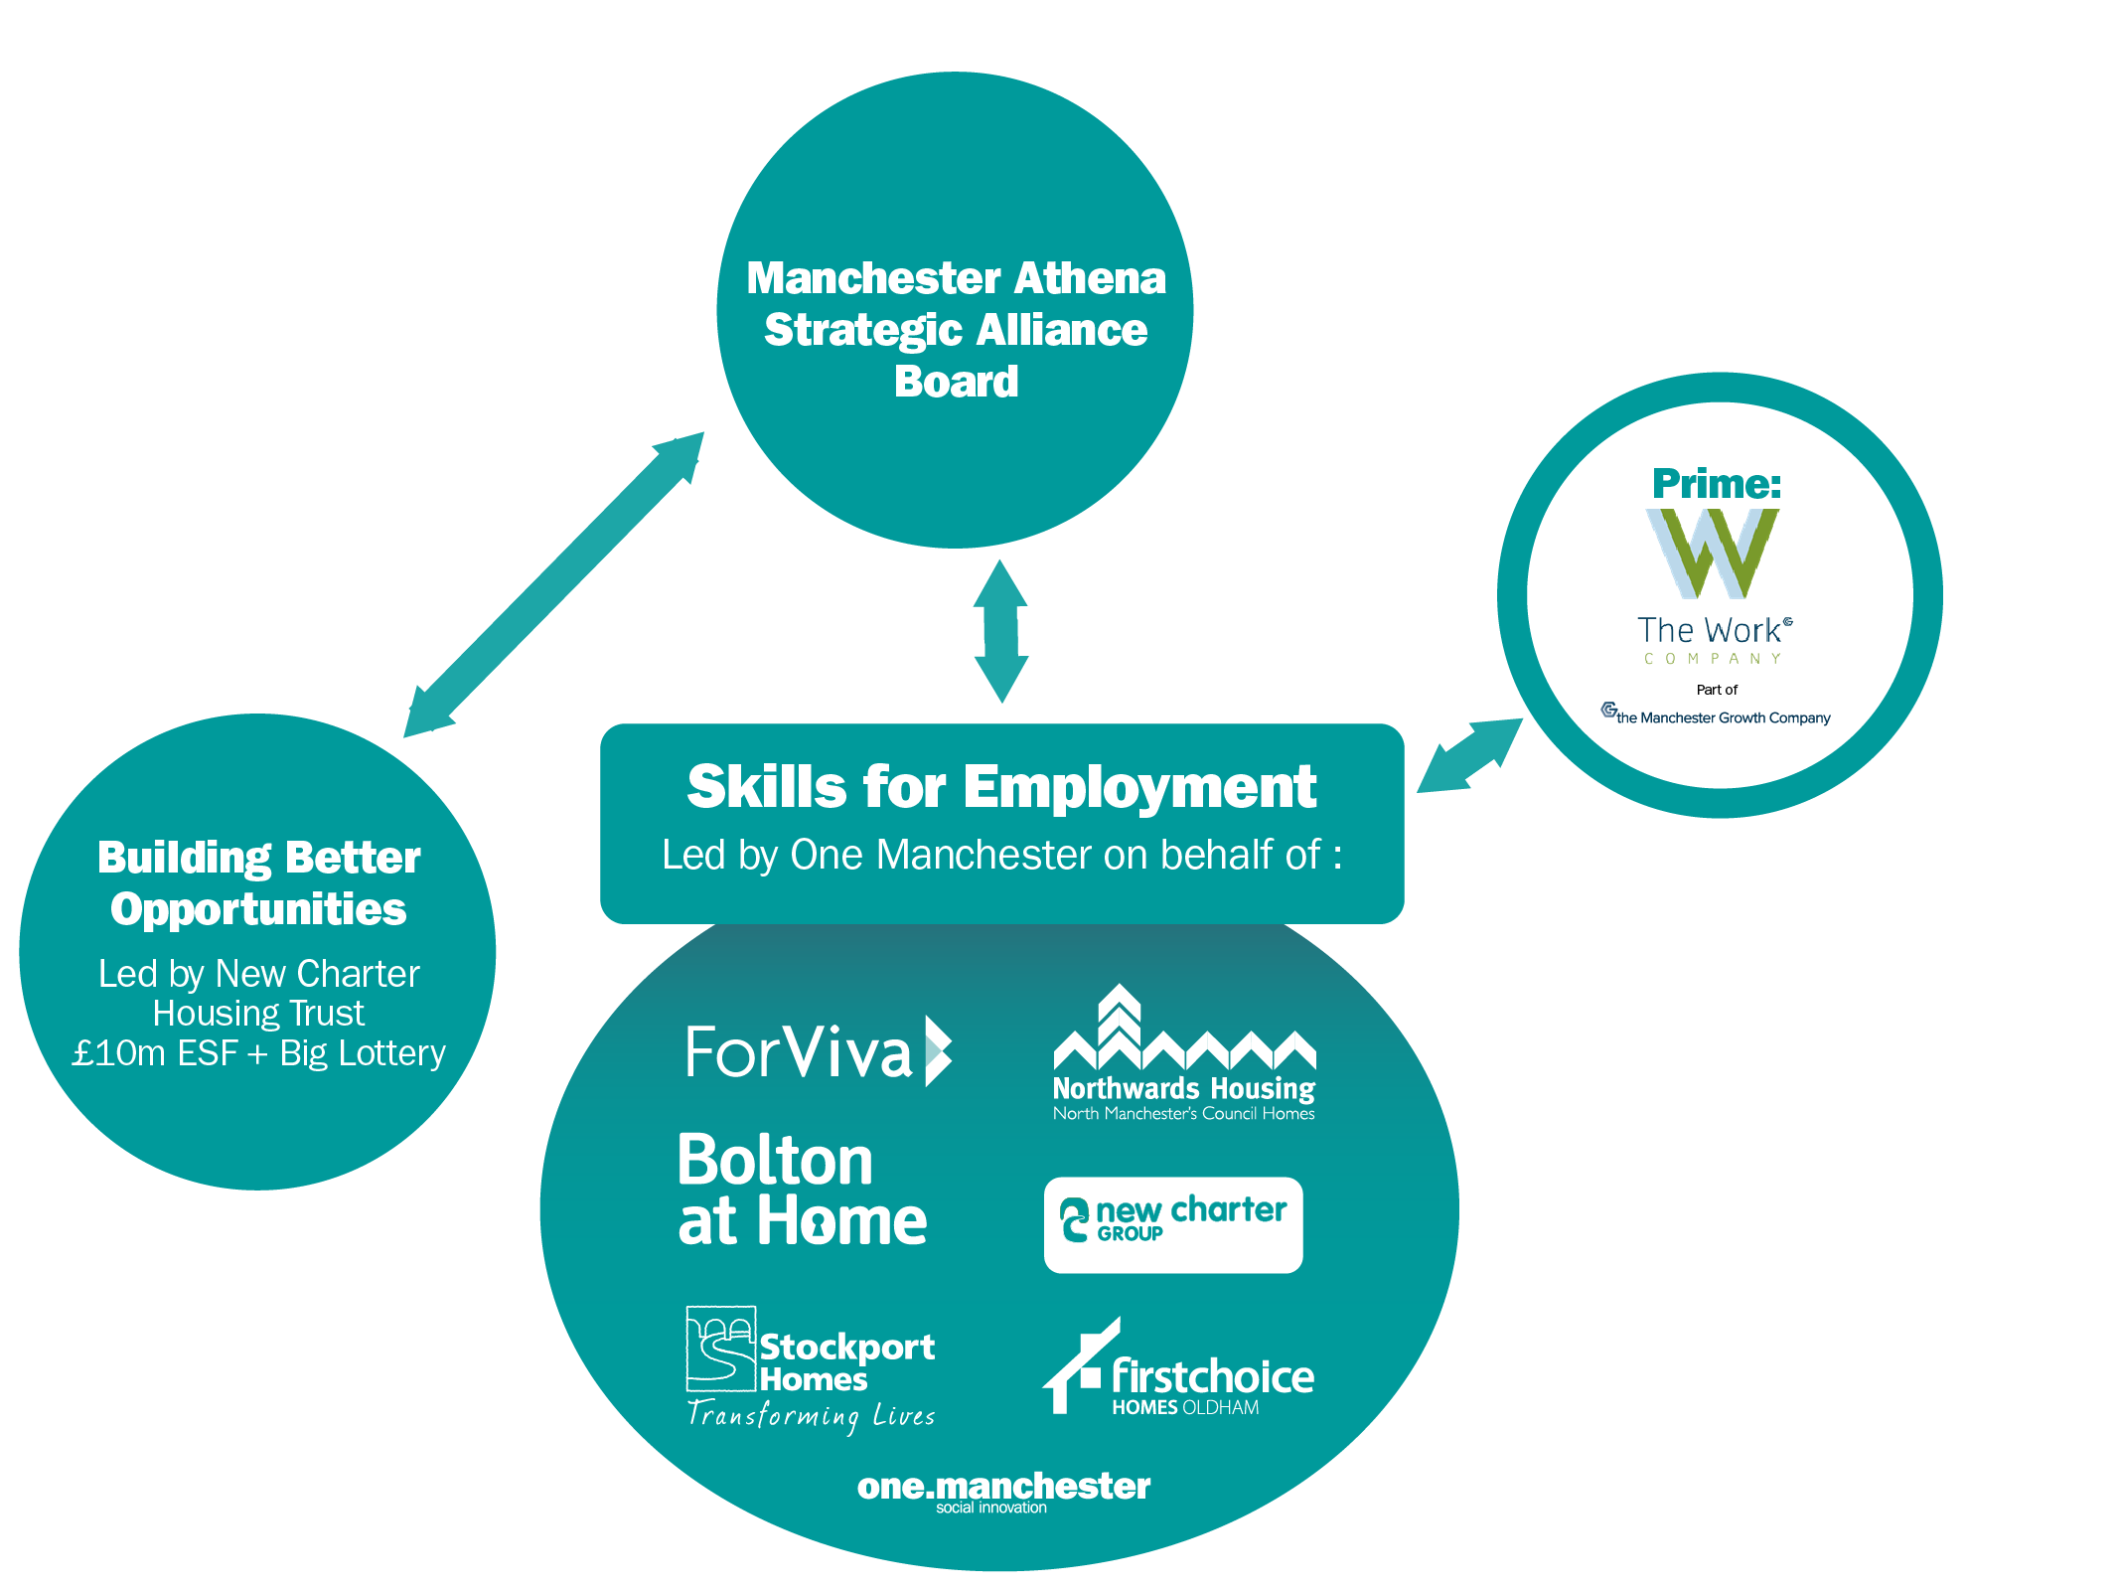

Slide 21
GM Futures Strategic Alliance
Partners:
GM Chamber of Commerce
GM Learning Provider Network
The Manchester Growth Company
The Manchester College
Notes:
Manchester Growth Company comprises of;
Economic solutions
The Work Company
The Skills Company
Business Growth Hub
Marketing Manchester
New Economy

Slide 22
Tips & lessons learned
Customer intelligence and insight - diagnostic assessment
Additionality and connectivity - utilise your partnerships
Build on track record – be prepared to adjust to suit audience
Package up range of products – end-to-end delivery, accredited & non-accredited training, placements
Know where your / everyone’s red line is
Be a real player in your marketplace – provider and strategy
Let opportunity drive vehicle
Smart investment

